Slide 1

Yelp Dataset Challenge
Real People Real Reviews
By: Bhatkal, Apurva
Kallianpur, Vinit
Dalal, Vivek
Under the guidance of Prof. Shrikant Krishnamurthi & Ashwin Dinoriya

Slide 2
DATA
The Challenge Dataset:
2.7M reviews and 649K tips by 687K users for 86K businesses
566K business attributes, e.g., hours, parking availability, ambience.
Social network of 687K users for a total of 4.2M social edges.
Aggregated check-ins over time for each of the 86K businesses
200,000 pictures from the included businesses

Slide 3
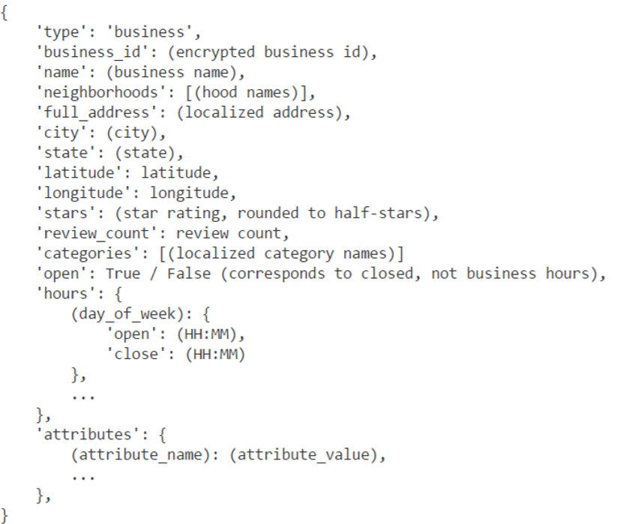
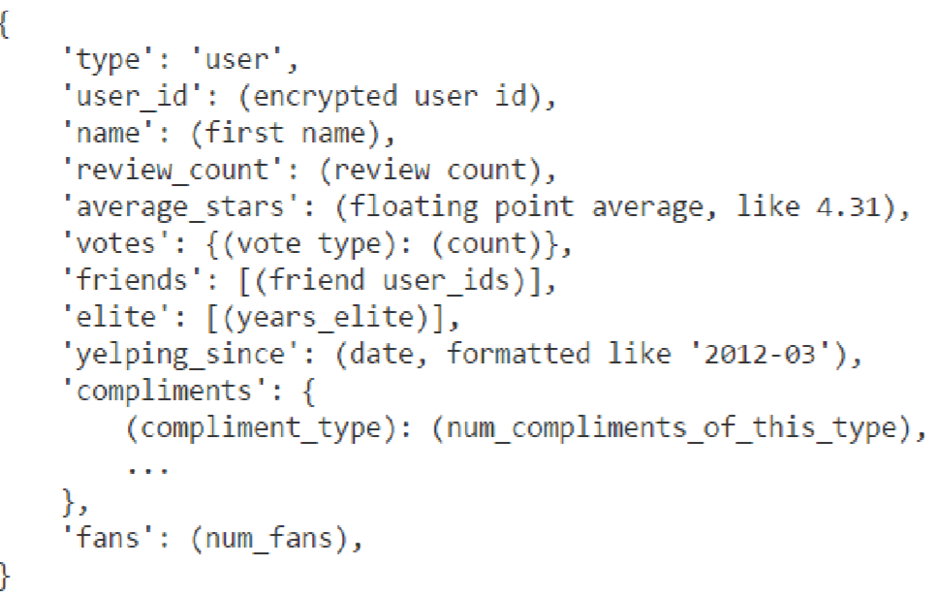
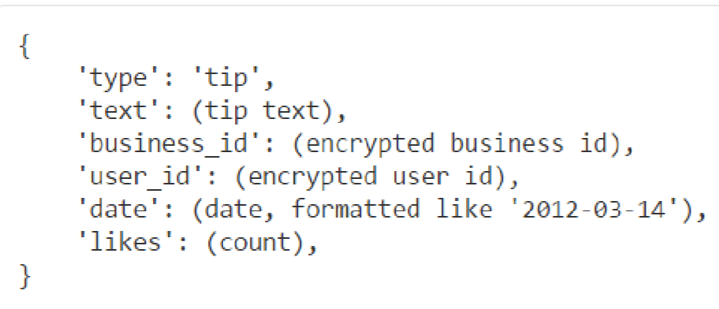
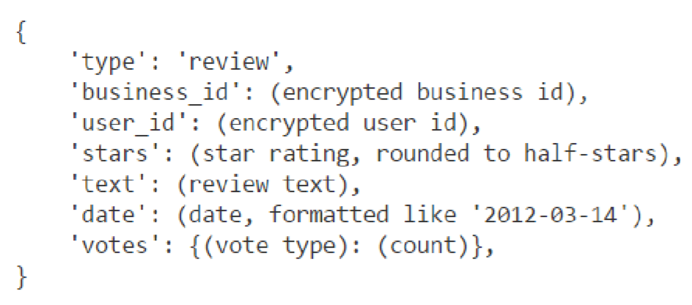
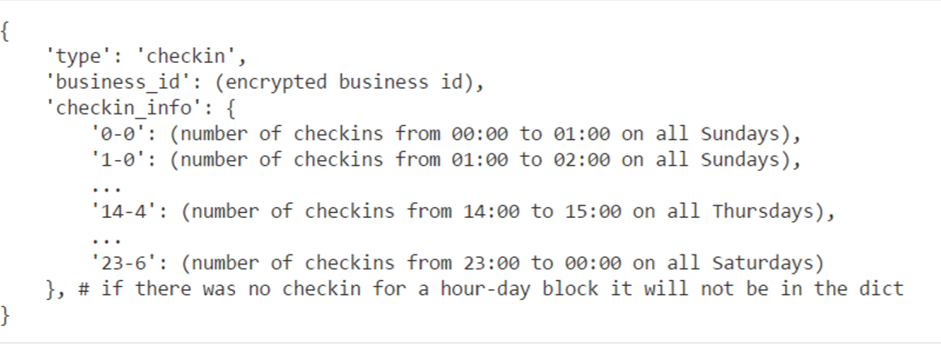
TABLES
Business.json
Reviews.json
User.json
Tips.json
Chcekin.json

Slide 4
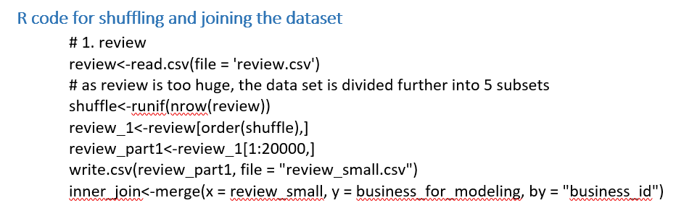
CLEANING THE DATASET

Slide 5
TABLEAU EXPLORATORY ANALYSIS
Demo

Slide 6
PREDICTIVE MODELS
Recommendation Systems
Text Analysis of Reviews of a Business
Live Text Analysis
Prediction of Ratings of a new Business

Slide 7
AZURE DEMO

Slide 8
Q&A

Slide 9
Thank you.

